Slide 1
How many do you see?
How do you see them?
How many do you see?
How do you see it?

Slide 2
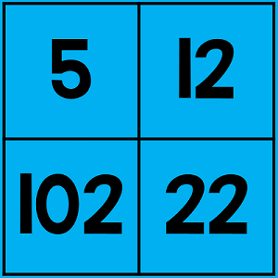
Which One Doesn’t Belong?
Why?
Which one doesn't belong?
Why?

Slide 3
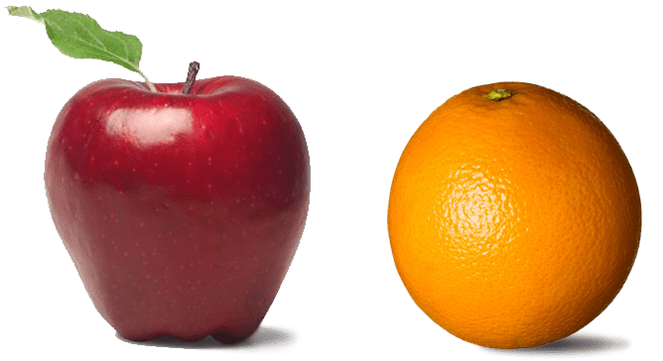
Same or Different?
What do you notice is the same about these pictures? What do you notice is different?
1
2
3
4

Slide 4
Would you rather…
have 364 jellybeans and give 188 to friends or
have 281 jellybeans and give 137 to friends?
Why?

Slide 5
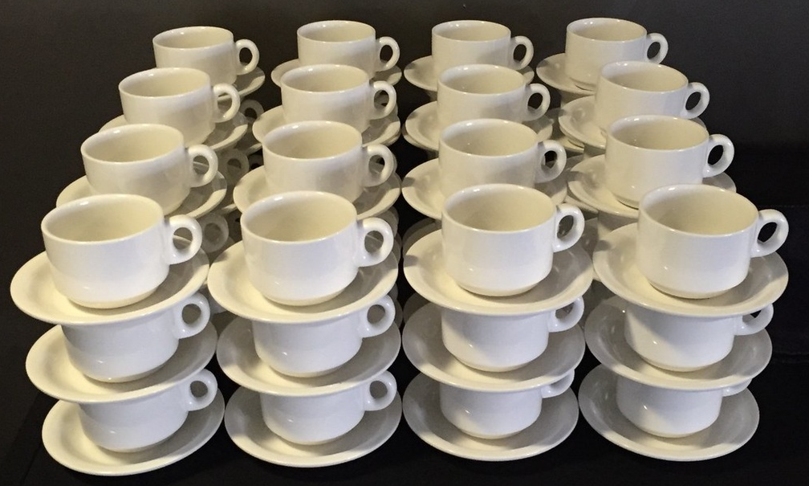
How many do you see?
How do you see it?

Slide 6
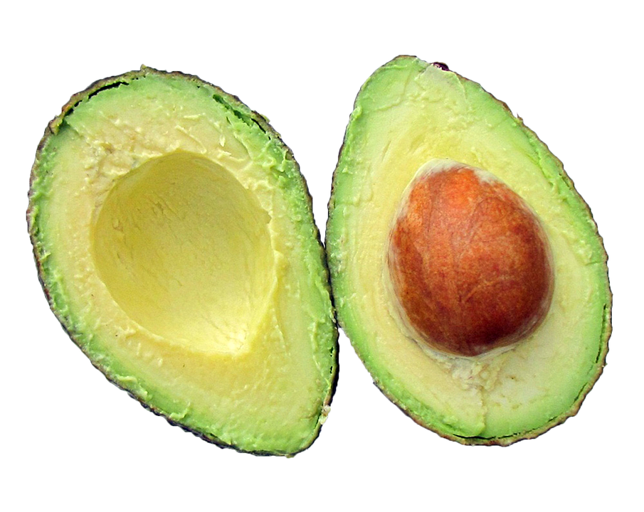
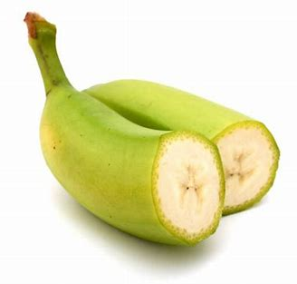
Same or Different?
What do you notice is the same about these pictures? What do you notice is different?
1
2
3
4

Slide 7
Mystery Number
This number is between
1 and 1000
It is an odd number.
The sum of the digits is 14.
It is the number of days in a year.
What might the mystery number be?

Slide 8
How many do you see?
How do you know?
How sure are you?
What number might the dot represent?
Justify your thinking.
Notes:
Benchmarks
Make a number line: https://www.mathwarehouse.com/number-lines/number-line-maker.php – only goes up to 100
Number Line Maker Generator | Common-Core Math Resources (helpingwithmath.com) for 10 000 and 1 000 000

Slide 9
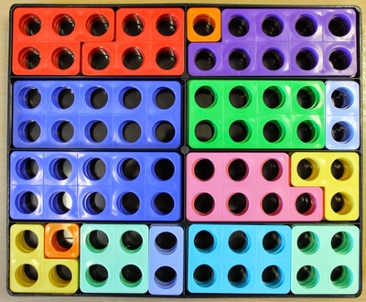
How many do you see?
How do you see it?

Slide 10
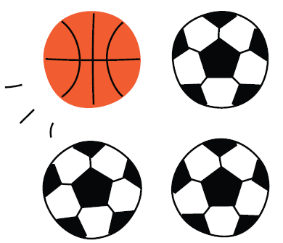
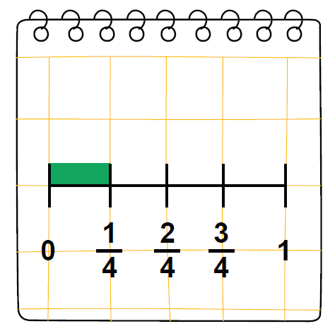
Same or Different?
What do you notice is the same about these pictures? What do you notice is different?

Slide 11
How many do you see?
How do you see it?

Slide 12
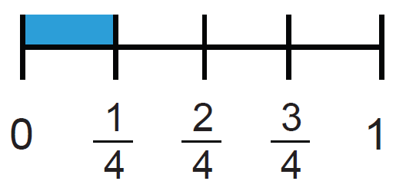
Same or Different?
What do you notice is the same about these pictures? What do you notice is different?
1
2
3
4

Slide 13
How many do you see?
How do you know?
0
1 000
How sure are you?
What number might the dot represent?
Justify your thinking.
Notes:
Benchmark
Make a number line: https://www.mathwarehouse.com/number-lines/number-line-maker.php – only goes up to 100
Number Line Maker Generator | Common-Core Math Resources (helpingwithmath.com) for 10 000 and 1 000 000

